Slide 1
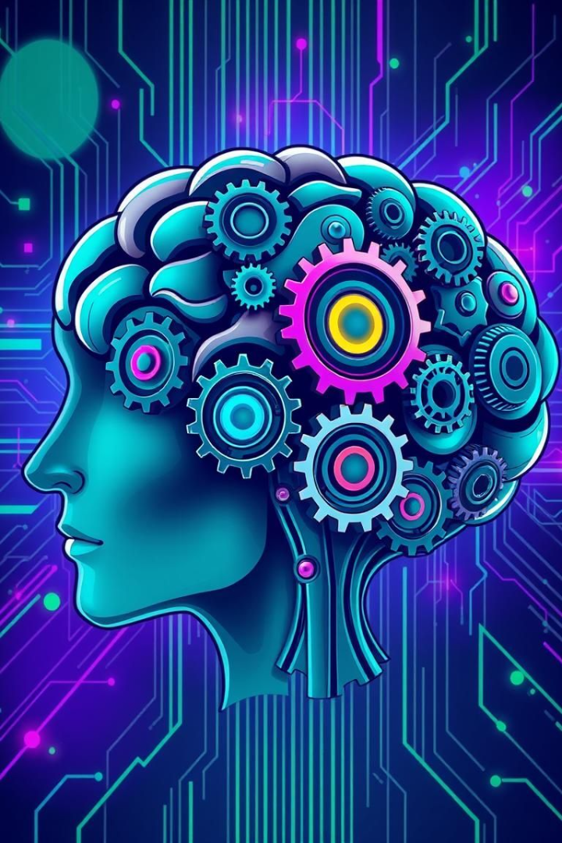

Artificial Intelligence in Ideation: Unleashing Creativity
This presentation explores the exciting world of AI-powered ideation, showcasing its potential to revolutionize the way we think and create.
by ShaTech jsjk

Slide 2
The Power of AI in Idea Generation
Beyond Human Limits
Unleashing Creativity
AI can analyze vast datasets and identify patterns humans might miss, leading to innovative and unexpected ideas.
AI can spark new inspiration by suggesting novel combinations of existing concepts, encouraging out-of-the-box thinking.

Slide 3
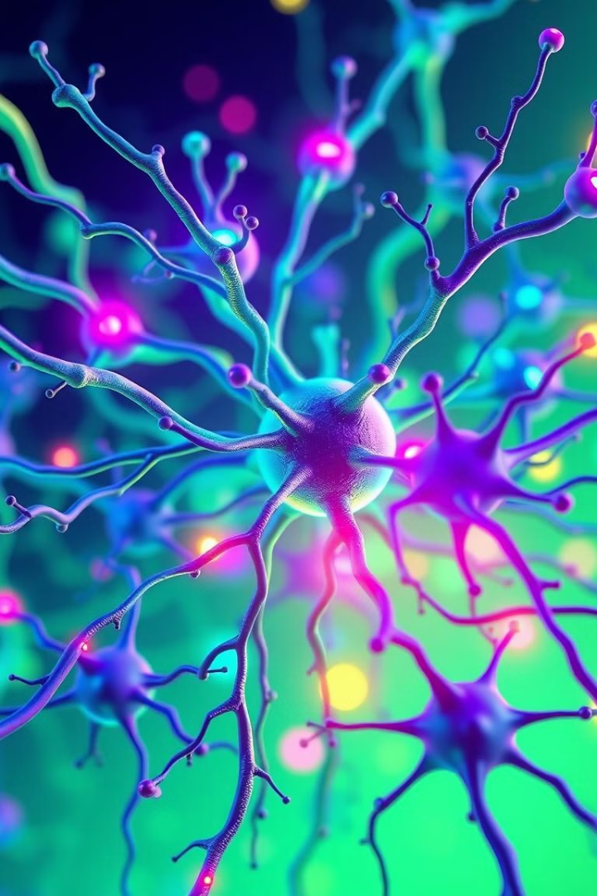
Harnessing AI for Brainstorming and Trend Analysis
1
AI-Powered Brainstorming
2
Trend Analysis
AI can analyze large amounts of data to identify emerging trends and predict consumer behavior, informing strategic decision-making.
AI tools can facilitate group brainstorming by generating ideas, categorizing them, and identifying the most promising ones.

Slide 4
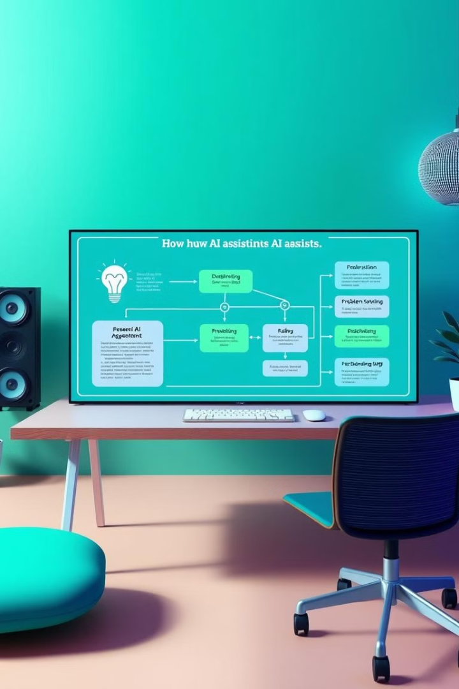



Integrating AI to Streamline the Creative Workflow
Idea Generation
AI can generate initial concepts, exploring different possibilities and providing a diverse range of options to consider.
Refining and Testing
AI can help refine ideas, test their feasibility, and identify potential risks and opportunities.
Prototyping and Iteration
AI can assist in prototyping and iterating on ideas, accelerating the development and refinement process.

Slide 5

Overcoming Challenges: Data Limitations and Creative Blocks
Data Quality
Bias Mitigation
Human-AI Collaboration
Ensuring the accuracy and completeness of data is crucial for AI to generate relevant and reliable insights.
Addressing biases in training data is essential to ensure fair and equitable outcomes from AI-driven ideation.
The most effective ideation process involves a collaborative approach where AI complements human creativity and critical thinking.

Slide 6
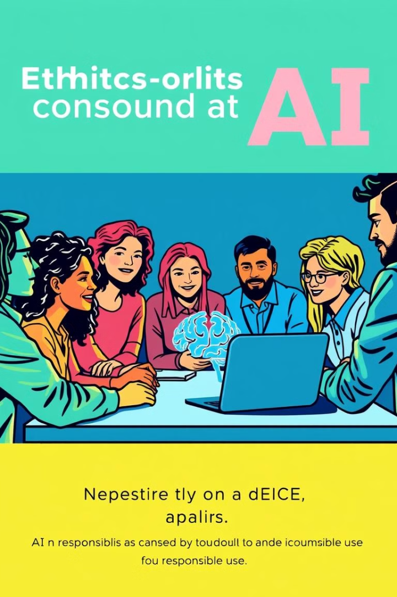



Ethical Considerations: Bias, Transparency, and Accountability
Fairness and Equity
Transparency and Explainability
AI algorithms should be designed and implemented in a way that avoids perpetuating existing biases and promotes fairness.
It's important to understand how AI reaches its conclusions to ensure transparency and accountability.
Accountability and Oversight
There should be clear mechanisms for holding AI developers and users accountable for the ethical implications of their work.

Slide 7
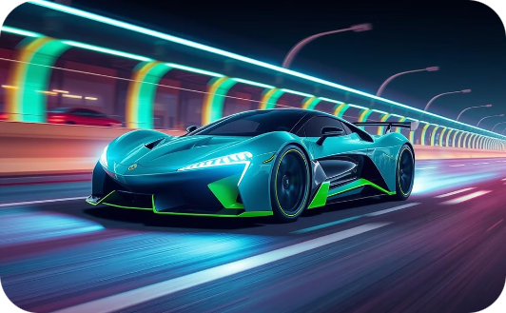


Case Studies: Real-World Examples of AI-Powered Ideation
Automotive Design
Personalized Marketing
Healthcare Innovations
AI is being used to design vehicles with improved safety, performance, and efficiency.
AI is revolutionizing marketing by enabling personalized recommendations and tailoring experiences to individual preferences.
AI is being applied to diagnose diseases, develop new treatments, and improve patient care outcomes.

Slide 8

The Future of AI in Innovation: Endless Possibilities
The fusion of AI and human creativity holds immense potential to unlock groundbreaking ideas and solutions, shaping a future where innovation knows no bounds.

